Slide 1
Corporate

Slide 2
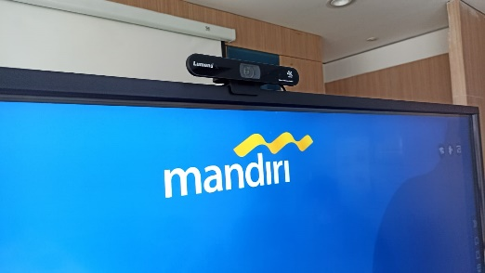
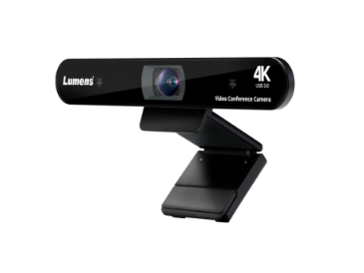
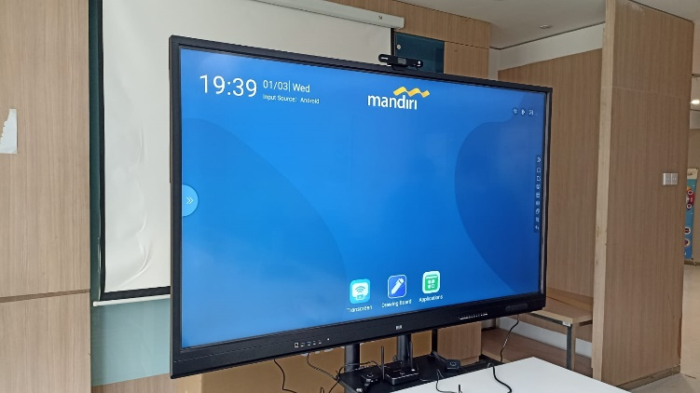
Interactive Display Meeting Room for Bank Mandiri IT Infrastructure Division
Indonesia
Success Stories
Corporate
Product: VC-B11U
PT Bank Mandiri (Persero) Tbk or Bank Mandiri, headquartered in Jakarta, is the largest bank in Indonesia in terms of assets, loans and deposits. As of December 2020, the bank had 2,511 branches spread across three different time zones in Indonesia and 7 branches abroad, about 13,217 Automatic Teller Machines (ATMs), and five principal subsidiaries.
The client wanted to have an interactive meeting room that can accommodate for online and offline meeting in IT Infrastructure Division.
“After seeing multiple demos of different USB camera brand, Lumens product were finalized considering the product quality of the camera along with auto framing feature and easy of operation via simple remote.”
Mr. Pras, IT Infra Manager of Bank Mandiri

Slide 3
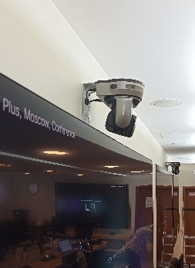
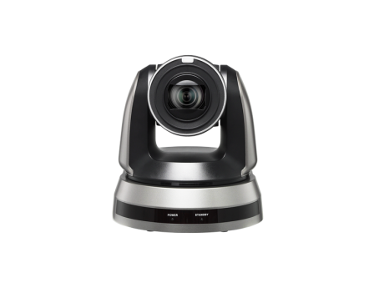
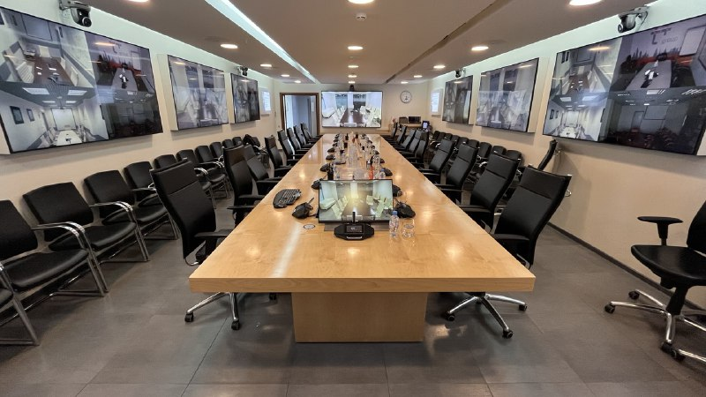
Conference room in TPlus head office
Russia
Success Stories
Corporate
The purpose of the modernization was to create a multifunctional meeting room for conferences with the possibility of active participation of each of those present both indoors and remotely. There are a large number of monitors, PTZ video cameras and a congress system in this room.
Product: VC-A61P
T Plus Group is the largest Russian private company operating in the field of electricity and heat supply. T Plus Group owns 6% of the installed capacity of Russian power plants. The company provides stable and uninterrupted power supply in 16 regions of Russia.
Upgrading the meeting and conference room with modern multimedia equipment for meetings with regional branches and partners has become a necessity.
During negotiations, the cameras are automatically turn to the speaking person, who can be seen on monitors located around the perimeter of the room. Meeting participants attending remotely are also visible to everyone.
“The meeting room has become more functional. Automatic cameras management by using a congress system and presets makes it possible to hold meetings in a completely autonomous manner, without the participation of technical personnel. After the upgrading we can use old conference codec with new equipment and better visualization. New management system gave us opportunities we haven’t before. An excellent image quality and comfortable workspace are necessary for successful work” — Jul., 2019
IT Administrator of TPlus main office

Slide 4
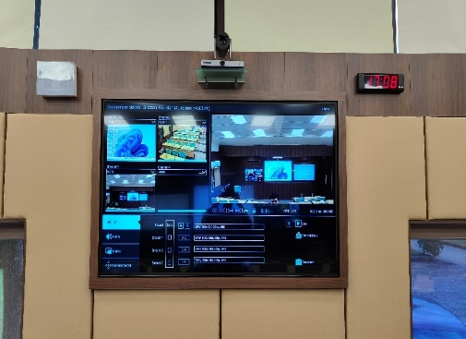
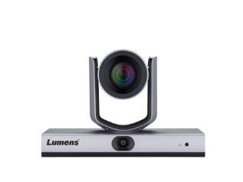
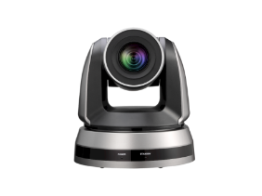
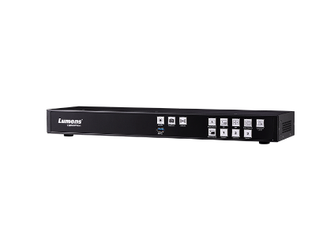
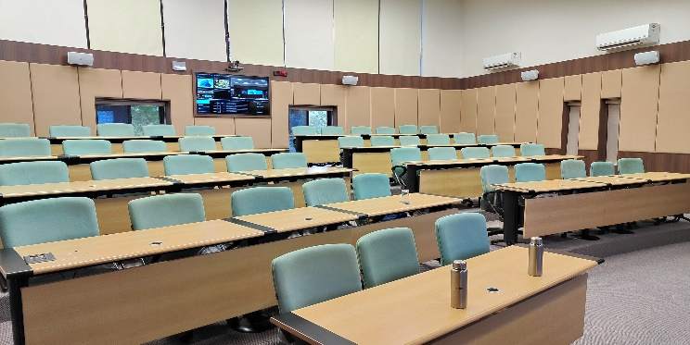
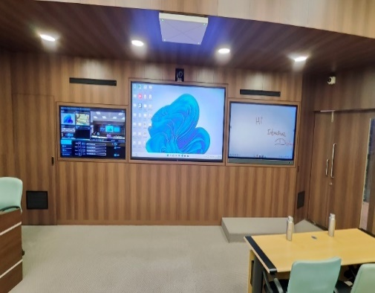
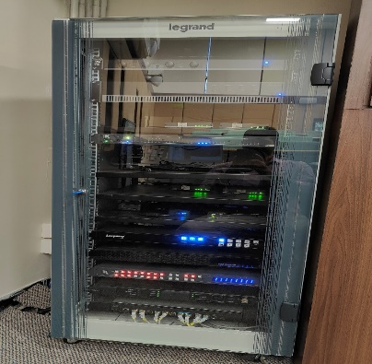
Mahindra & Mahindra
Nashik, India
Success Stories
Corporate
Lumens camera integrated with ceiling tile solutions.
Application recording and VC.
Product: VC-TR1, VC-A51P, LC200

Slide 5
Khet Udomsak Subdistrict Municipality Office
Thailand
Success Stories
Corporate
Product: VC-A61P
Meeting room 48 seats in Khet Udomsak Subdistrict Municipality Office. PTZ IP Cameras VC-A61P x 3 Units paired with Bosch CCSD1000D are used to capture speakers on IP based

Slide 6
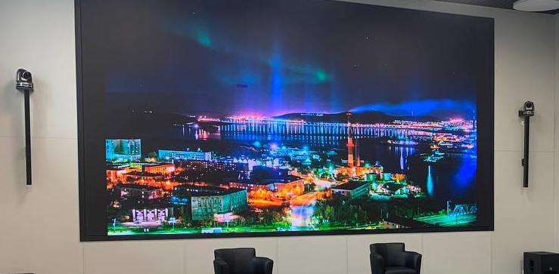
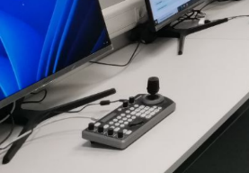
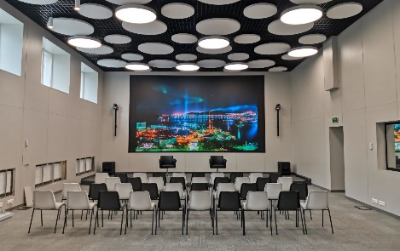
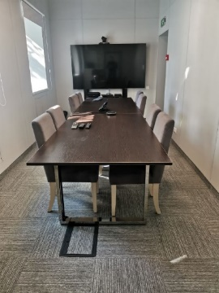
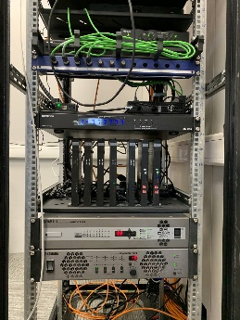
ITC Murmansk
Russia
Success Stories
Corporate
Product:VC-A71P, VC-B30U, VS-KB30, LC200
Multimedia solution for video conferencing, training and presentations, as well as broadcasting using the Lumens LC200 media processor and VC-A71P cameras in the assembly hall and VC-B30U camera in the conference room, which are connected to each other to ensure simultaneous operation.
“Management thanks Interactive Digital Solutions Company for their efficiency in delivery and installation. All works from design, delivery and installation to commissioning of the facility were carried out at a high professional level and in a short time.”
Head of Information Technology Center in Murmansk Region
Igor Egorov

Slide 7
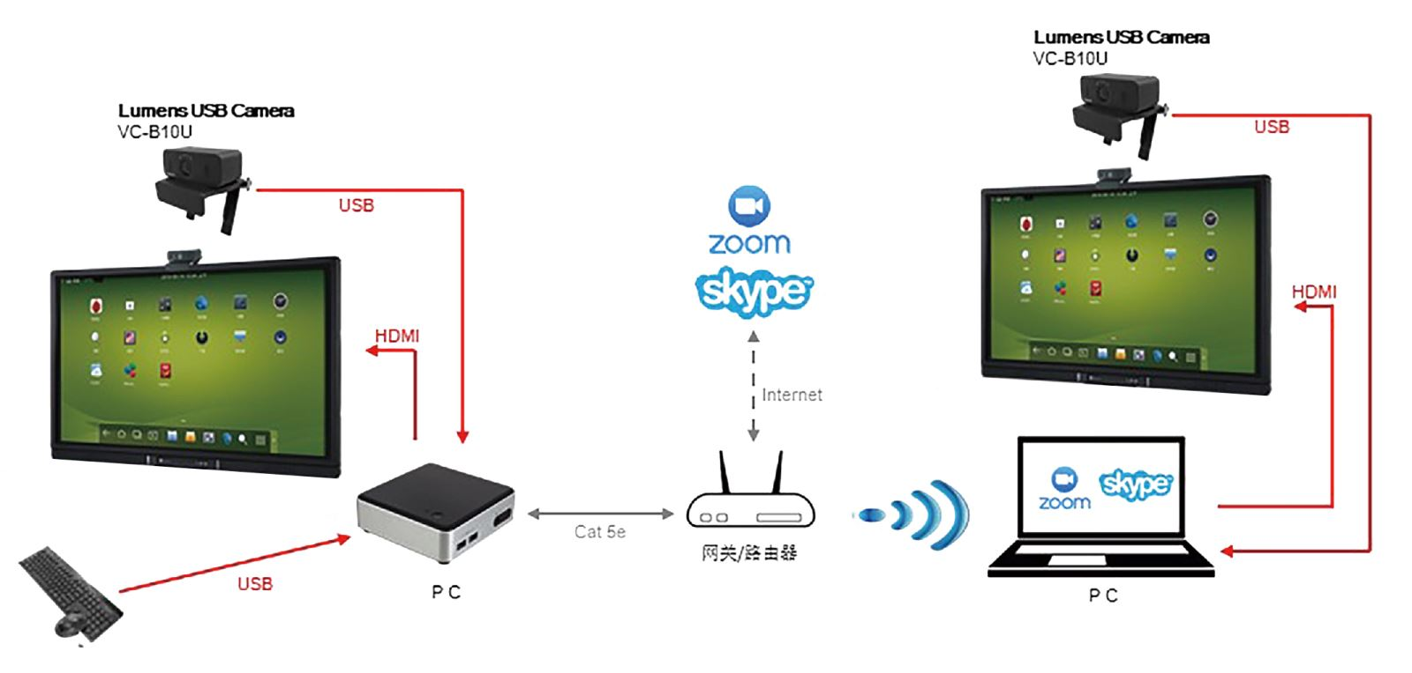
TATA
China
Success Stories
Corporate
Product: VC-B10U
USB 3.0 Plug & Play function
Auto-adjustment microphone satisfied the demand of conference equipment.
120° Ultra-wide Angle lens
“Lumens USB camera satisfied our meeting request in small size meeting room. TATA Corporate will keep apply this model for employees to elevate the meeting expeirence.”
Rehan Mirza
TATA Corporate

Slide 8
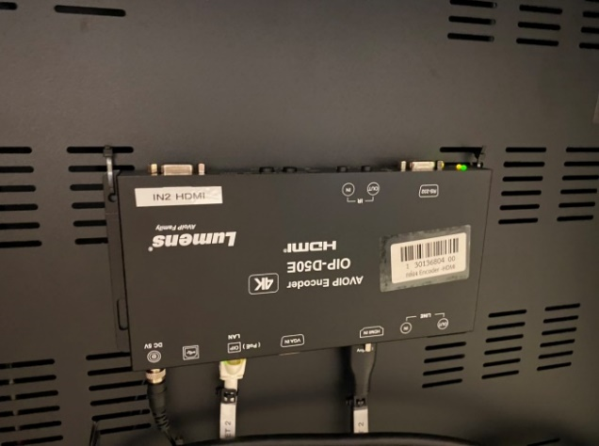
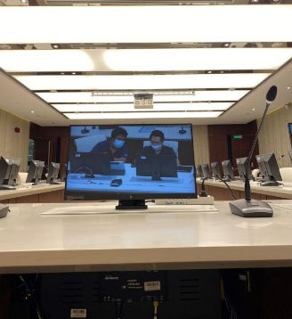
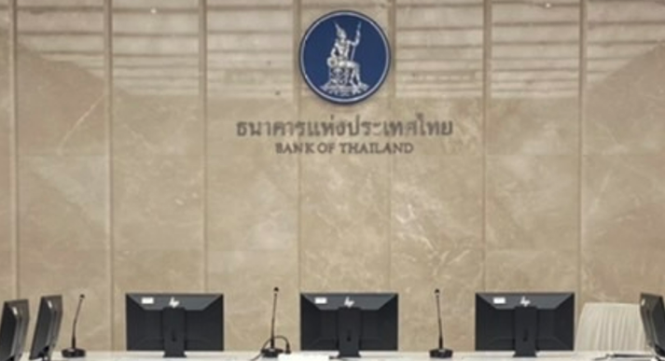
Bank Of Thailand
Thailand
Success Stories
Corporate
Product: OIP-D50C、OIP-D50D、OIP-D50E
Combining meeting room solution with Lumens AV over IP, The image switching command must be used via automation system with 4 PTZ cameras and 5 HDMI input.

Slide 9
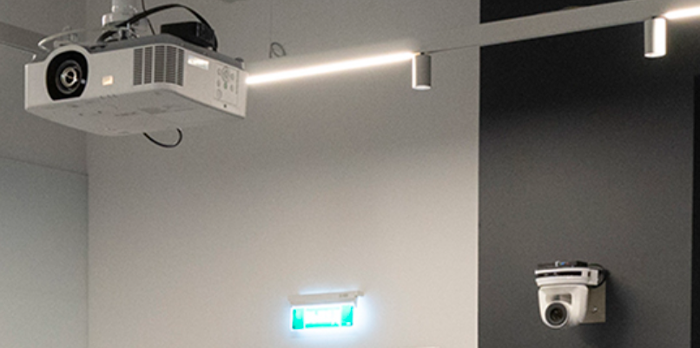
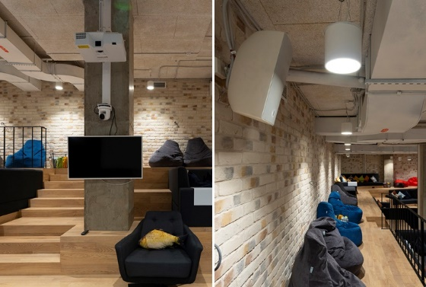
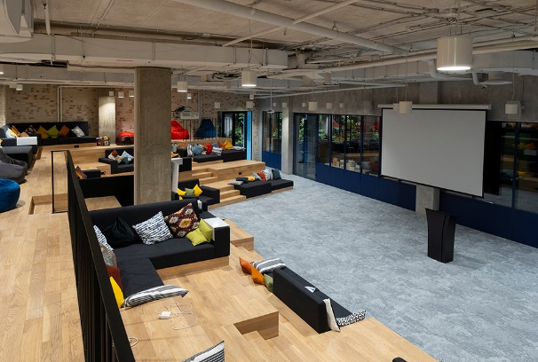
Joom, Russia
Success Stories
Corporate
Product: VC-A50P
The main pride of the office is the conference room. The atmosphere of the loft cinema intersects here with the best modern technology. Yamaha audio system, Draper Targa motorized projection screen, Maxell 3LCD laser projector. All systems are managed by ATEN controller. Lumens camera can follow a speaker's moving. The training is constantly transmitted by Internet for the distant learning.
Some of more than 15 meeting rooms with multimedia systems have Lumens camera for video conferencing
I can confidently say that this project included all aspects, tasks and solutions of office design. But this is exactly what the office of the future should be. The freedom of movement and choice we have created in this office increases employee motivation and mood. The Joom office is a space where you want to return, and its visual and functional diversity will not have time to get bored for a very, very long time. This is the kind of place you can live in while working.
Chief Architect of the project
Evgeny Kovpak

Slide 10
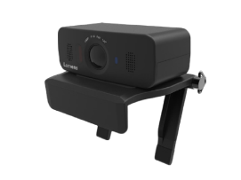
Sunwest Group of Companies
Philippines
Success Stories
Corporate
Product: VC-B30U, VC-B10U
Sunwest has a lot of meeting rooms and satellite offices, thus having a videocon solution is valid enough to be used for their scheduled and emergency meetings.
With the use of the B30U and B10U cameras for executive boardrooms, medium-sized meeting rooms and discussion hubs, video conferencing is easier with its crystal clear resolution.
Lumens cameras are flexible for all types of videocon solutios.
“IWe like the resolution of Lumens cameras. It makes vidoe collab more flawless.”

Slide 11
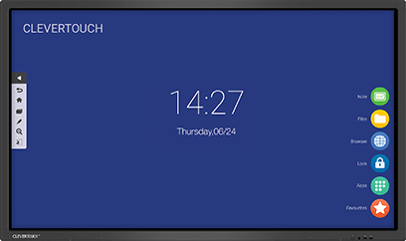
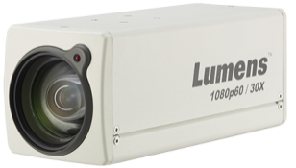
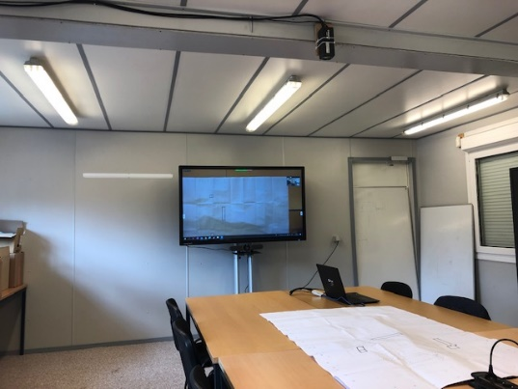
MBG Construction
Belgium
Success Stories
Corporate
Product: VC-BC601P
The MBG construction company works on massive construction, like underground parking and large buildings. Often, architects and workers need to discuss with clients via conference call about the development.
The VC-BC601P is installed on the ceiling to serve as an overview camera. Both sides can see the whole blueprint via Zoom. They also annotate over the blueprint with the interactive flat panel.
Clevertouch Interactive Screen
HDMI
HDMI
USB
USB converter
Laptop

Slide 12
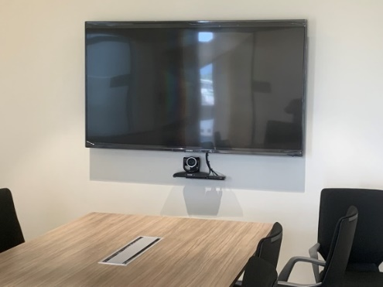
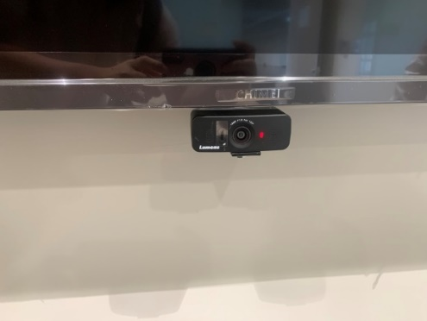
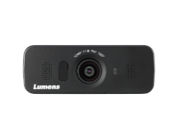
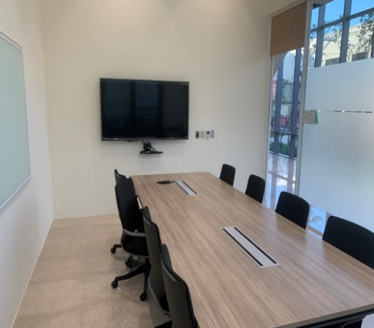
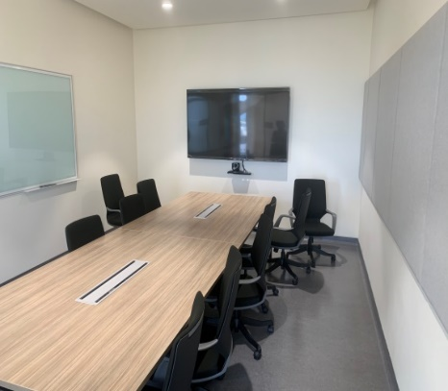
MOXA
Taiwan
Success Stories
Corporate
Product: VC-B30U, VC-B10U
Every meeting room equips with simple plug & play conferencing camera. PTZ conferencing camera VC-B30U and USB camera VC-B10U are installed based on the size of the meeting rooms.
In the meeting room, MOXA employees can launch a video conference via Zoom or Skype with their laptops.
“VC-B30U and VC-B10U these two USB cameras are suitable for any size of the meeting rooms we have. Employees can attend a video conference simple by connecting their laptops, and the image quality is crystal.”
Ricky Chang
Project Supervisor, Operation of IT department, MOXA Taiwan

Slide 13
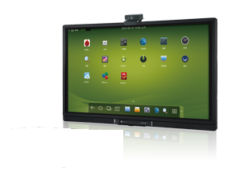
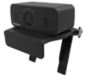
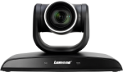
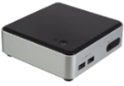
MOXA
Taiwan
Success Stories
Corporate
Product: VC-B30U, VC-B10U
Conferecing Camera
VC-B10U
USB
HDMI
HDMI
Conferencing Camera
VC-B30U
USB
PC
USB
Ethernet
BYOD

Slide 14
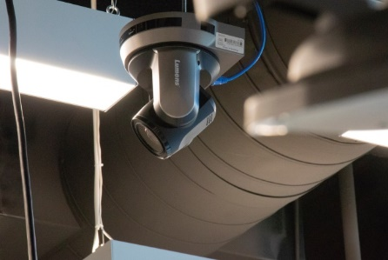
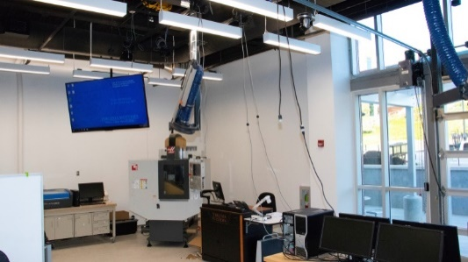
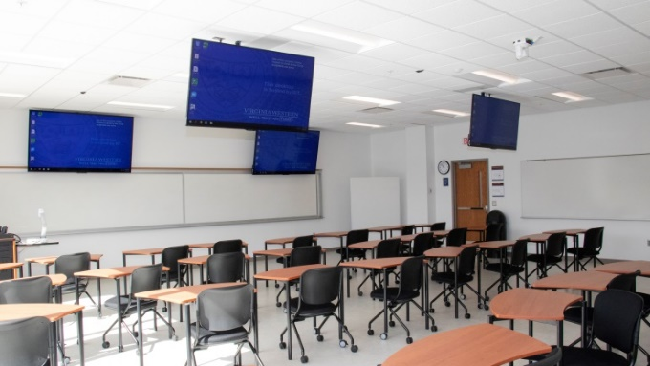
Western Virginia STEM Building
USA
Success Stories
Corporate
Product: VC-A70H
Virginia Western’s new STEM Building is 27 classroom facility that supports a multitude of emerging technologies such as robotics, biotechnology, and mechatronics.
VC-A70H cameras are used to support lecture capture and video conferencing software such as Zoom, Panopto, and Canvas Studio.
Paired with a Crestron DMPS3-350-C control system, instructors are able to seamlessly incorporate video into their distance courses. The HDBaseT interface allows for easy Crestron integration via their DigitalMedia platform.
“Lumens VC-A70H 4K camera was chosen for its exceptional quality and support. We made the switch to Lumens cameras several years ago and never looked back. In a side by side demonstration, the instructor satisfaction made the VC-A70H the only choice for our new STEM building.”
Joe Bear
Head Media Geek, Virginia Western Community College

Slide 15
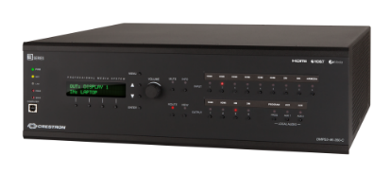
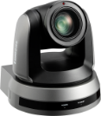
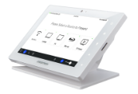
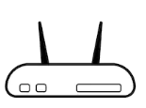
Western Virginia STEM Building
USA
Success Stories
Corporate
Display
Display
Product: VC-A70H
HDMI
HDMI
Why VC-A70H
Speaker
4K UHD signal output is essential to capturing STEM applications.
Quick and easy installation in either a wall or ceiling mounted solution.
HDBaseT carries power, video, and control through one Cat5e/6 cable
Audio
HDBaseT
PoDM
Cat 5e/6
Lumens PTZ Camera
VC-A70H
Crestron Presentation System
DMPS3-4K-350-C
Crestron Control Panel
TSW-760
Cat 5e/6
Crestron Encoder
DM-TXRX-100-STR
Cat 5e/6
LAN
Cat 5e/6
Cat 5e/6
Router

Slide 16
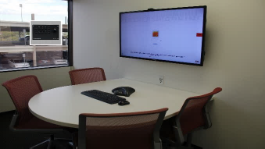
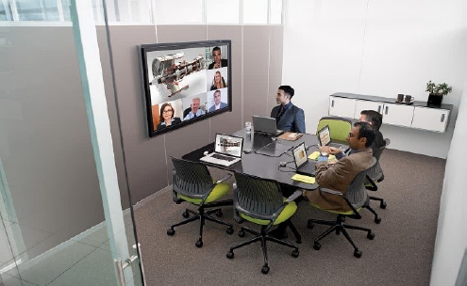
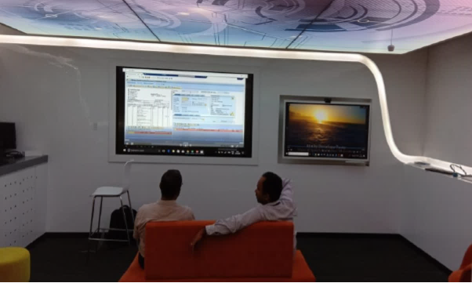
TATA
India
Success Stories
Corporate
Product: VC-B10U
TATA Consultancy Services (TCS), the world’s largest IT services provider, have used VC-B10U with Microsoft Zoom, Skype, Webex, and Adobe for video conference.
B10U built-in microphone with TV speaker for team chat
“Lumens USB camera satisfied our meeting request in small size meeting room. TATA Corporate will keep apply this model for employees to elevate the meeting expeirence.”
Rehan Mirza
TATA Corporate

Slide 17
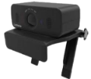
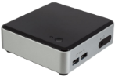
TATA
India
Success Stories
Corporate
Product: VC-B10U
Lumens USB Camera
VC-B10U
Lumens USB Camera
VC-B10U
USB
USB
HDMI
HDMI
PC
USB
Ethernet
BYOD

